Slide 1
CS4222
Principles of Database System
1. Relational Algebra
Huiping Guo
Department of Computer Science
California State University, Los Angeles

Slide 2
Outline
Unary Relational Operations
Relational Algebra Operations From Set Theory
Binary Relational Operations
Additional Relational Operations
Examples of Queries in Relational Algebra
1. algebra CS4222
1-<number>

Slide 3
Introduction
A data model must also include a set of operations to manipulate the database in addition to the data model’s concepts for defining database structure and constraints
Query languages allow manipulation and retrieval of data from a database.
Two mathematical Query Languages form the basis for “real” languages (e.g. SQL), and for implementation:
  Relational Algebra: Define a basic set of operations for the relational model. These operations enable a user to specify basic retrieval requests (or queries)
  Relational Calculus: Lets users describe what they want, rather than how to compute it. (Non-operational, declarative.)
1. algebra CS4222
1-<number>

Slide 4
Relational Algebra Overview
In relational algebra, the result of an operation is a new relation, which may have been formed from one or more input relations
The algebra operations thus produce new relations
  These can be further manipulated using operations of the same algebra
A sequence of relational algebra operations forms a relational algebra expression
  The result of a relational algebra expression is also a relation that represents the result of a database query (or retrieval request)
1. algebra CS4222
1-<number>

Slide 5
Relational Algebra Overview
Relational Algebra consists of several groups of operations
  Unary Relational Operations
    SELECT (symbol: σ (sigma))
    PROJECT (symbol: π (pi))
    RENAME (symbol: ρ (rho))
  Relational Algebra Operations From Set Theory
    UNION ( ∪ ), INTERSECTION ( ∩ ), DIFFERENCE (or MINUS, – )
    CARTESIAN PRODUCT ( x )
  Binary Relational Operations
    JOIN (several variations of JOIN exist)
    DIVISION
  Additional Relational Operations
    OUTER JOINS, OUTER UNION
    AGGREGATE FUNCTIONS (These compute summary of information: for example, SUM, COUNT, AVG, MIN, MAX)
1. algebra CS4222
1-<number>

Slide 6

Database State for COMPANY
All examples discussed below refer to the COMPANY database shown here.
1. algebra CS4222
1-<number>

Slide 7

A database state of COMPANY
1. algebra CS4222
1-<number>

Slide 8
Unary Relational Operations: SELECT
The SELECT operation (denoted by σ (sigma)) is used to select a subset of the tuples from a relation based on a selection condition.
  The selection condition acts as a filter
  Keeps only those tuples that satisfy the qualifying condition
  Tuples satisfying the condition are selected whereas the other tuples are discarded (filtered out)
Examples:
  Select the EMPLOYEE tuples whose department number is 4:
σ _{DNO = 4} (EMPLOYEE)
  Select the employee tuples whose salary is greater than $30,000:
σ _{SALARY > 30,000} (EMPLOYEE)
1. algebra CS4222
1-<number>

Slide 9
Unary Relational Operations: SELECT
In general, the select operation is denoted by σ _{<selection condition>}(R) where
  the symbol σ (sigma) is used to denote the select operator
  the selection condition is a Boolean (conditional) expression specified on the attributes of relation R
  tuples that make the condition true are selected
    appear in the result of the operation
  tuples that make the condition false are filtered out
    discarded from the result of the operation
1. algebra CS4222
1-<number>

Slide 10
Unary Relational Operations: SELECT
SELECT Operation Properties
  The SELECT operation σ _{<selection condition>}(R) produces a relation S that has the same schema (same attributes) as R
  SELECT σ is commutative:
    σ _{<condition1>}(σ _{< condition2>} (R)) = σ _{<condition2>} (σ _{< condition1>} (R))
  Because of commutativity property, a cascade (sequence) of SELECT operations may be applied in any order:
    σ_{<cond1>}(σ_{<cond2>} (σ_{<cond3>} (R)) = σ_{<cond2>} (σ_{<cond3>} (σ_{<cond1>} ( R)))
  A cascade of SELECT operations may be replaced by a single selection with a conjunction of all the conditions:
    σ_{<cond1>}(σ_{< cond2>} (σ_{<cond3>}(R)) = σ <cond1> AND < cond2> AND < cond3>(R)))
  The number of tuples in the result of a SELECT is less than (or equal to) the number of tuples in the input relation R
1. algebra CS4222
1-<number>

Slide 11
Unary Relational Operations: PROJECT
PROJECT Operation is denoted by π (pi)
This operation keeps certain columns (attributes) from a relation and discards the other columns.
  PROJECT creates a vertical partitioning
    The list of specified columns (attributes) is kept in each tuple
    The other attributes in each tuple are discarded
Example: To list each employee’s first and last name and salary, the following is used:
  π_{LNAME, FNAME,SALARY}(EMPLOYEE)
1. algebra CS4222
1-<number>

Slide 12
Unary Relational Operations: PROJECT
The general form of the project operation is:
π_{<attribute list>}(R)
  π (pi) is the symbol used to represent the project operation
  <attribute list> is the desired list of attributes from relation R.
The project operation removes any duplicate tuples
  This is because the result of the project operation must be a set of tuples
    Mathematical sets do not allow duplicate elements.
1. algebra CS4222
1-<number>

Slide 13
Unary Relational Operations: PROJECT
PROJECT Operation Properties
  The number of tuples in the result of projection π_{<list>}(R) is always less or equal to the number of tuples in R
    If the list of attributes includes a key of R, then the number of tuples in the result of PROJECT is equal to the number of tuples in R
  PROJECT is not commutative
    π _{<list1>} (π _{<list2>} (R) ) = π _{<list1>} (R) as long as <list2> contains the attributes in <list1>
1. algebra CS4222
1-<number>

Slide 14
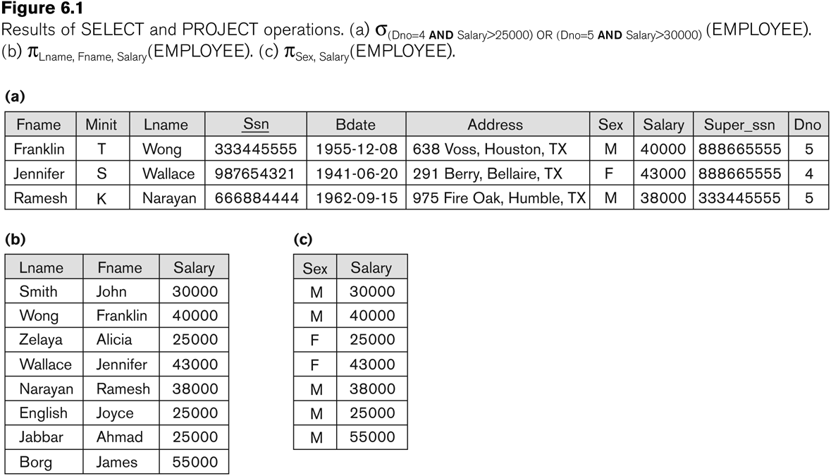
Examples of applying SELECT and PROJECT operations
1. algebra CS4222
1-<number>

Slide 15
Relational Algebra Expressions
We may want to apply several relational algebra operations one after the other
  Either we can write the operations as a single relational algebra expression by nesting the operations, or
  We can apply one operation at a time and create intermediate result relations.
In the latter case, we must give names to the relations that hold the intermediate results.
1. algebra CS4222
1-<number>

Slide 16
Example
To retrieve the first name, last name, and salary of all employees who work in department number 5, we must apply a select and a project operation
We can write a single relational algebra expression as follows:
  π_{FNAME, LNAME, SALARY}(σ _{DNO=5}(EMPLOYEE))
OR We can explicitly show the sequence of operations, giving a name to each intermediate relation:
  DEP5_EMPS ← σ _{DNO=5}(EMPLOYEE)
  RESULT ← π _{FNAME, LNAME, SALARY} (DEP5_EMPS)
1. algebra CS4222
1-<number>

Slide 17
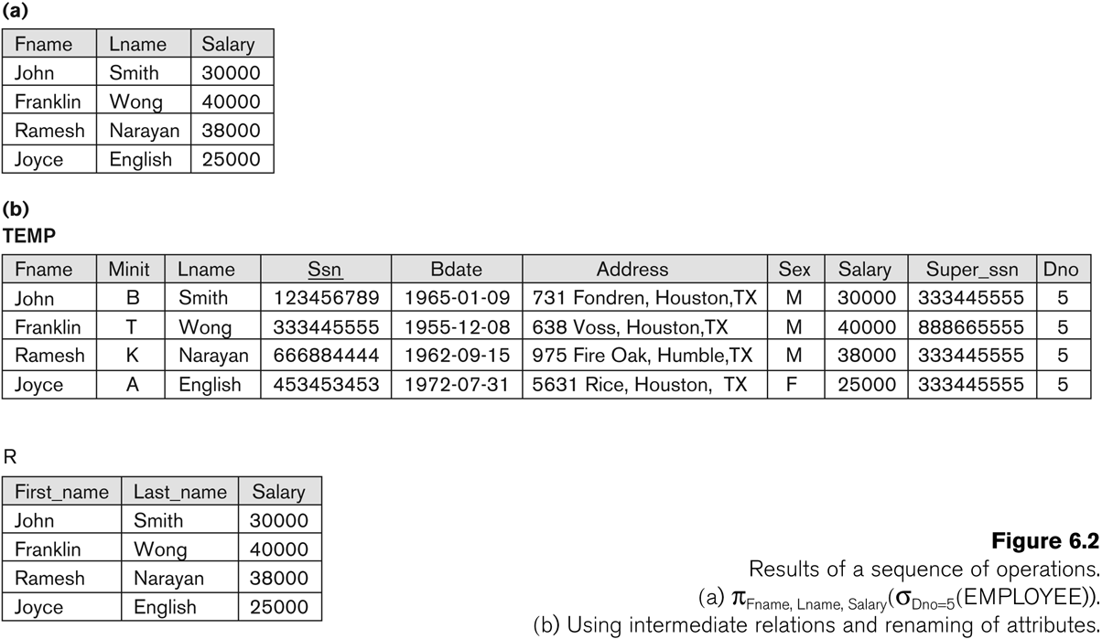
Example
1. algebra CS4222
1-<number>

Slide 18
Unary Relational Operations: RENAME
The RENAME operator is denoted by ρ (rho)
In some cases, we may want to rename the attributes of a relation or the relation name or both
  Useful when a query requires multiple operations
  Necessary in some cases (see JOIN operation later)
1. algebra CS4222
1-<number>

Slide 19
Unary Relational Operations: RENAME
The general RENAME operation ρ can be expressed by any of the following forms:
  ρ_{S (B1, B2, …, Bn )}(R) changes both:
    the relation name to S, and
    the column (attribute) names to B1, B1, …..Bn
  ρ_{S}(R) changes:
    the relation name only to S
  ρ_{(B1, B2, …, Bn )}(R) changes:
    the column (attribute) names only to B1, B1, …..Bn
1. algebra CS4222
1-<number>

Slide 20
Unary Relational Operations: RENAME
For convenience, we also use a shorthand for renaming attributes in an intermediate relation
If we write:
  RESULT ← π _{FNAME, LNAME, SALARY} (DEP5_EMPS)
  RESULT will have the same attribute names as DEP5_EMPS (same attributes as EMPLOYEE)
1. algebra CS4222
1-<number>

Slide 21
Relational Algebra Operations from
Set Theory: UNION
C = A U B
1
5
7
8
7
3
5
U
5
6
9
1
5
7
7
8
No duplicates!
3
5
6
5
9
1. algebra CS4222
1-<number>

Slide 22
Relational Algebra Operations from
Set Theory: UNION
UNION Operation
  Binary operation, denoted by ∪
  The result of R ∪ S, is a relation that includes all tuples that are either in R or in S or in both R and S
  Duplicate tuples are eliminated
  The two operand relations R and S must be “type compatible” ( also for INTERSECTION ∩, and SET DIFFERENCE –, )
    R and S must have same number of attributes
    Each pair of corresponding attributes must have the same domain.
    Note: attribute names do NOT matter
1. algebra CS4222
1-<number>

Slide 23
Relational Algebra Operations from
Set Theory: UNION
Example:
  To retrieve the social security numbers of all employees who either work in department 5 (RESULT1 below) or directly supervise an employee who works in department 5 (RESULT2 below)
  We can use the UNION operation as follows:
DEP5_EMPS ← σ_{DNO=5} (EMPLOYEE)
RESULT1 ← π _{SSN}(DEP5_EMPS)
RESULT2(SSN) ← π_{SUPERSSN}(DEP5_EMPS)
RESULT ← RESULT1 ∪ RESULT2
  The union operation produces the tuples that are in either RESULT1 or RESULT2 or both
1. algebra CS4222
1-<number>

Slide 24
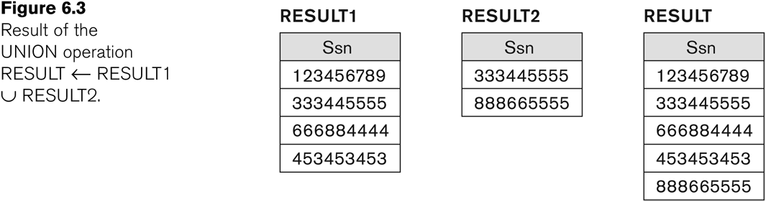
Example of the result of a UNION operation
UNION Example
1. algebra CS4222
1-<number>

Slide 25
Relational Algebra Operations from Set Theory: INTERSECTION
INTERSECTION is denoted by ∩
The result of the operation R ∩ S, is a relation that includes all tuples that are in both R and S
  The attribute names in the result will be the same as the attribute names in R
The two operand relations R and S must be “type compatible”
1. algebra CS4222
1-<number>

Slide 26
Relational Algebra Operations from Set Theory: SET DIFFERENCE
SET DIFFERENCE (also called MINUS or EXCEPT) is denoted by –
The result of R – S, is a relation that includes all tuples that are in R but not in S
  The attribute names in the result will be the same as the attribute names in R
The two operand relations R and S must be “type compatible”
1. algebra CS4222
1-<number>

Slide 27
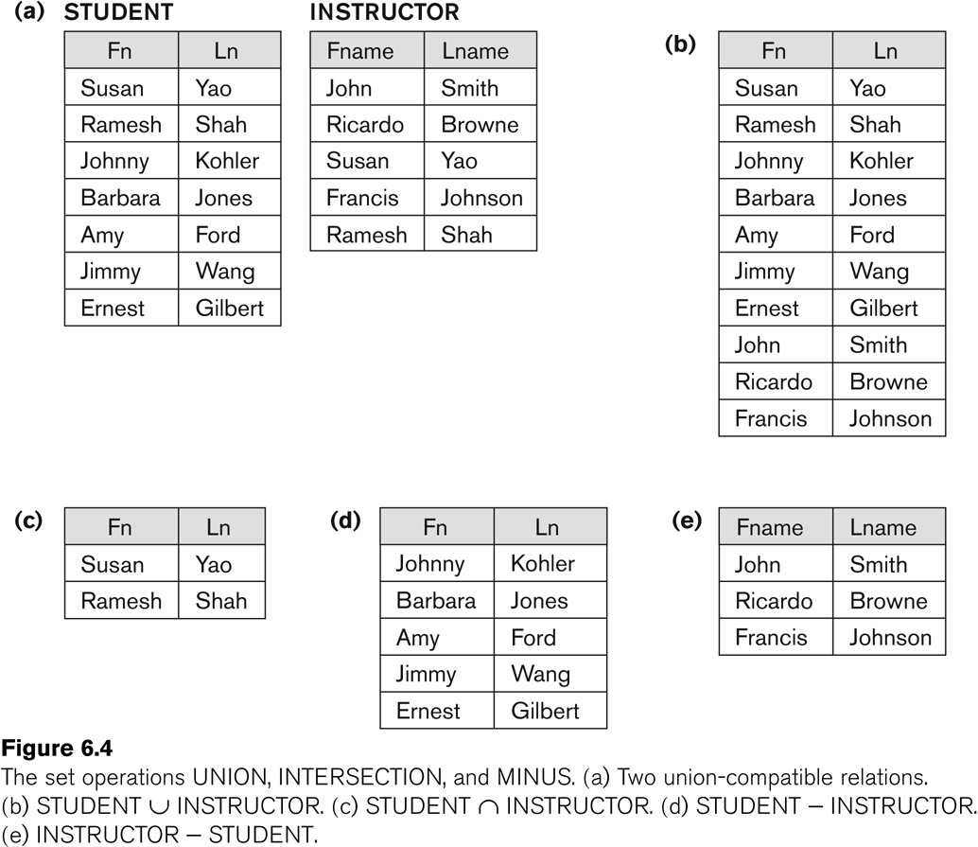
Example to illustrate the result of UNION, INTERSECT, and DIFFERENCE
1. algebra CS4222
1-<number>

Slide 28
Some properties of UNION, INTERSECT, and DIFFERENCE
Notice that both union and intersection are commutative operations; that is
  R ∪ S = S ∪ R, and R ∩ S = S ∩ R
Both union and intersection can be treated as n-ary operations applicable to any number of relations as both are associative operations; that is
  R ∪ (S ∪ T) = (R ∪ S) ∪ T
  (R ∩ S) ∩ T = R ∩ (S ∩ T)
The minus operation is not commutative; that is, in general
  R – S ≠ S – R
1. algebra CS4222
1-<number>

Slide 29
Question
If you didn’t have an Intersection operator in relational algebra, how could you express the intersection operation using only set difference and union operator?
A ∩ B=???
Ans : A ∩ B = A-(A-B)=B-(B-A)
1. algebra CS4222
1-<number>

Slide 30
Relational Algebra Operations from Set Theory: CARTESIAN PRODUCT
CARTESIAN (or CROSS) PRODUCT Operation
  This operation is used to combine tuples from two relations in a combinatorial fashion.
  Denoted by R(A1, A2, . . ., An) x S(B1, B2, . . ., Bm)
  Result is a relation Q with degree n + m attributes:
    Q(A1, A2, . . ., An, B1, B2, . . ., Bm), in that order.
  The resulting relation state has one tuple for each combination of tuples—one from R and one from S.
  Hence, if R has n_{R} tuples (denoted as |R| = n_{R} ), and S has n_{S} tuples, then R x S will have n_{R} * n_{S} tuples.
  The two operands do NOT have to be "type compatible”
1. algebra CS4222
1-<number>

Slide 31
Relational Algebra Operations from Set Theory: CARTESIAN PRODUCT
Generally, CROSS PRODUCT is not a meaningful operation
  Can become meaningful when followed by other operations
Example (not meaningful):
  FEMALE_EMPS ← σ _{SEX=’F’}(EMPLOYEE)
  EMPNAMES ← π _{FNAME, LNAME, SSN} (FEMALE_EMPS)
  EMP_DEPENDENTS ← EMPNAMES x DEPENDENT
EMP_DEPENDENTS will contain every combination of EMPNAMES and DEPENDENT
  whether or not they are actually related
1. algebra CS4222
1-<number>

Slide 32
Relational Algebra Operations from Set Theory: CARTESIAN PRODUCT
To keep only combinations where the DEPENDENT is related to the EMPLOYEE, we add a SELECT operation as follows
Example (meaningful):
  FEMALE_EMPS ← σ _{SEX=’F’}(EMPLOYEE)
  EMPNAMES ← π _{FNAME, LNAME, SSN} (FEMALE_EMPS)
  EMP_DEPENDENTS ← EMPNAMES x DEPENDENT
  ACTUAL_DEPS ← σ _{SSN=ESSN}(EMP_DEPENDENTS)
  RESULT ← π _{FNAME, LNAME, DEPENDENT_NAME} (ACTUAL_DEPS)
RESULT will now contain the name of female employees and their dependents
1. algebra CS4222
1-<number>

Slide 33
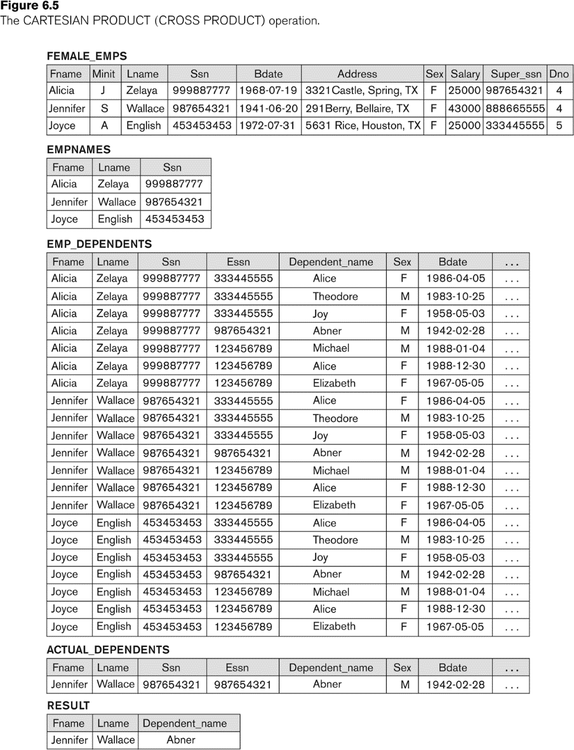
Example of applying CARTESIAN PRODUCT
1. algebra CS4222
1-<number>

Slide 34
Binary Relational Operations: JOIN
JOIN Operation (denoted by )
  The sequence of CARTESIAN PRODECT followed by SELECT is used quite commonly to identify and select related tuples from two relations
  A special operation, called JOIN combines this sequence into a single operation
  This operation is very important for any relational database with more than a single relation, because it allows us combine related tuples from various relations
  The general form of a join operation on two relations R(A1, A2, . . ., An) and S(B1, B2, . . ., Bm) is:
  R _{<join condition>}S
  where R and S can be any relations that result from general relational algebra expressions.
1. algebra CS4222
1-<number>

Slide 35
Binary Relational Operations: JOIN
Example: Suppose that we want to retrieve the name of the manager of each department.
  To get the manager’s name, we need to combine each DEPARTMENT tuple with the EMPLOYEE tuple whose SSN value matches the MGRSSN value in the department tuple.
  We do this by using the join operation.
  DEPT_MGR ← DEPARTMENT _{MGRSSN=SSN} EMPLOYEE
MGRSSN=SSN is the join condition
  Combines each department record with the employee who manages the department
  The join condition can also be specified as DEPARTMENT.MGRSSN= EMPLOYEE.SSN
1. algebra CS4222
1-<number>

Slide 36
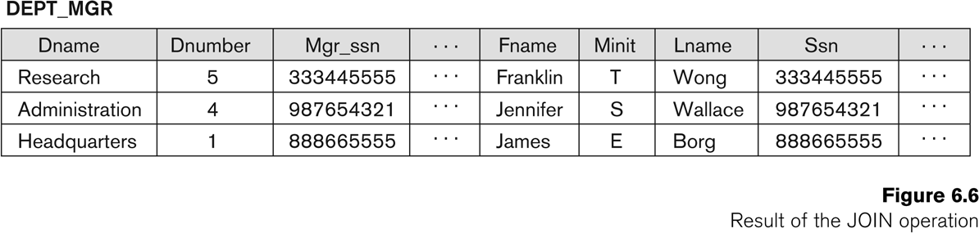
Example of applying the JOIN operation
DEPT_MGR ← DEPARTMENT _{MGRSSN=SSN} EMPLOYEE
1. algebra CS4222
1-<number>

Slide 37
Some properties of JOIN
Consider the following JOIN operation:
  R(A1, A2, . . ., An) S(B1, B2, . . ., Bm)
    R.Ai=S.Bj
  Result is a relation Q with degree n + m attributes:
    Q(A1, A2, . . ., An, B1, B2, . . ., Bm), in that order.
  The resulting relation state has one tuple for each combination of tuples—r from R and s from S, but only if they satisfy the join condition r[Ai]=s[Bj]
  Hence, if R has n_{R} tuples, and S has n_{S} tuples, then the join result will generally have less than n_{R} * n_{S} tuples.
  Only related tuples (based on the join condition) will appear in the result
1. algebra CS4222
1-<number>

Slide 38
Some properties of JOIN
The general case of JOIN operation is called a Theta-join: R S
    theta
The join condition is called theta
Theta can be any general boolean expression on the attributes of R and S; for example:
  R.Ai<S.Bj AND (R.Ak=S.Bl OR R.Ap<S.Bq)
Most join conditions involve one or more equality conditions “AND”ed together; for example:
  R.Ai=S.Bj AND R.Ak=S.Bl AND R.Ap=S.Bq
1. algebra CS4222
1-<number>

Slide 39
Binary Relational Operations: EQUIJOIN
EQUIJOIN Operation
The most common use of join involves join conditions with equality comparisons only
Such a join, where the only comparison operator used is =, is called an EQUIJOIN.
  In the result of an EQUIJOIN we always have one or more pairs of attributes (whose names need not be identical) that have identical values in every tuple.
  The JOIN seen in the previous example was an EQUIJOIN.
1. algebra CS4222
1-<number>

Slide 40
Binary Relational Operations:
NATURAL JOIN Operation
NATURAL JOIN Operation
  Another variation of JOIN called NATURAL JOIN — denoted by * — was created to get rid of the second (superfluous) attribute in an EQUIJOIN condition.
    because one of each pair of attributes with identical values is superfluous
  The standard definition of natural join requires that the two join attributes, or each pair of corresponding join attributes, have the same name in both relations
  If this is not the case, a renaming operation is applied first.
1. algebra CS4222
1-<number>

Slide 41
Binary Relational Operations NATURAL JOIN
Example: To apply a natural join on the DNUMBER attributes of DEPARTMENT and DEPT_LOCATIONS, it is sufficient to write:
  DEPT_LOCS ← DEPARTMENT * DEPT_LOCATIONS
Only attribute with the same name is DNUMBER
An implicit join condition is created based on this attribute:
  DEPARTMENT.DNUMBER=DEPT_LOCATIONS.DNUMBER
Another example: Q ← R(A,B,C,D) * S(C,D,E)
  The implicit join condition includes each pair of attributes with the same name, “AND”ed together:
    R.C=S.C AND R.D.S.D
  Result keeps only one attribute of each such pair:
    Q(A,B,C,D,E)
1. algebra CS4222
1-<number>

Slide 42
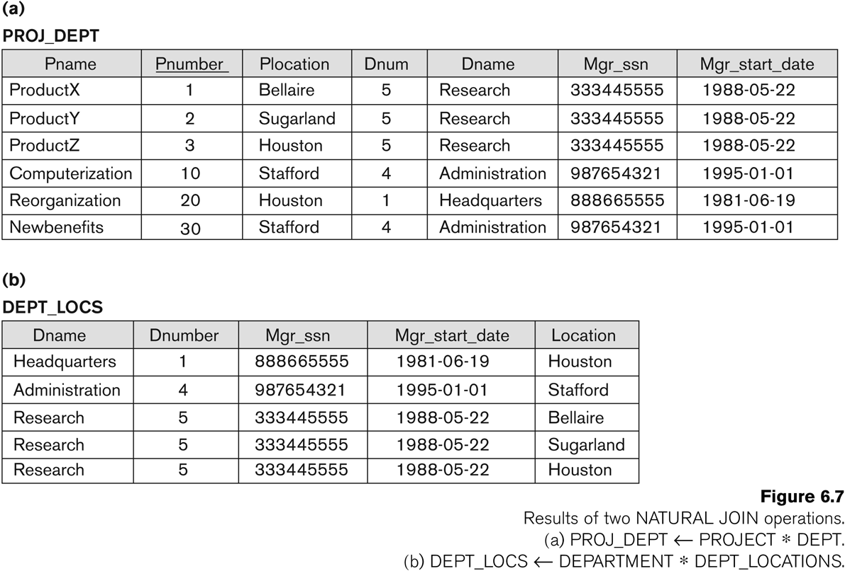
Example of NATURAL JOIN operation
1. algebra CS4222
1-<number>

Slide 43
Complete Set of Relational Operations
The set of operations including SELECT σ, PROJECT π , UNION ∪, DIFFERENCE − , RENAME ρ, and CARTESIAN PRODUCT X is called a complete
  because any other relational algebra expression can be expressed by a combination of these five operations.
For example:
  R ∩ S = (R ∪ S ) – ((R − S) ∪ (S − R))
  R _{<join condition>}S = σ _{<join condition>} (R X S)
1. algebra CS4222
1-<number>

Slide 44
Binary Relational Operations: DIVISION
The DIVISION operation (÷) is useful for a special kind of query
Eg: Find the names of employees who work on all the projects that “John Smith” works on
1. Find the list of project numbers that “John Smith” works on
  Smith ← σ Fname=“John” and Lname=“Smith”(Employee)
  Smith_PNOS ← π _{Pno}(Works_on _{Essn=Ssn} Smith)
2. Create a relation that includes a tuple <pno, Essn> whenever the employee whose SSn is Essn works on the project whose number is Pno
  SSN_PNOS ← π _{Essn},_{Pno}(Works_on)
3. Apply the DIVISION operation to the two relations
  SSNS(Ssn) ← SSN_PNOS ÷ SMITH_PNOS
  RESULT ← π _{Fname,Lname}(SSNS * Employee)
1. algebra CS4222
1-<number>

Slide 45
Binary Relational Operations: DIVISION
DIVISION Operation
  The division operation is applied to two relations
  R(Z) ÷ S(X), where X is a subset of Z.
  Let Y = Z - X (and hence Z = X ∪ Y); that is, let Y be the set of attributes of R that are not attributes of S.
  The result of DIVISION is a relation T(Y) that includes a tuple t if tuples t_{R} appear in R with t_{R} [Y] = t, and with
    t_{R} [X] = t_{s} for every tuple t_{s} in S.
  For a tuple t to appear in the result T of the DIVISION, the values in t must appear in R in combination with every tuple in S.
1. algebra CS4222
1-<number>

Slide 46
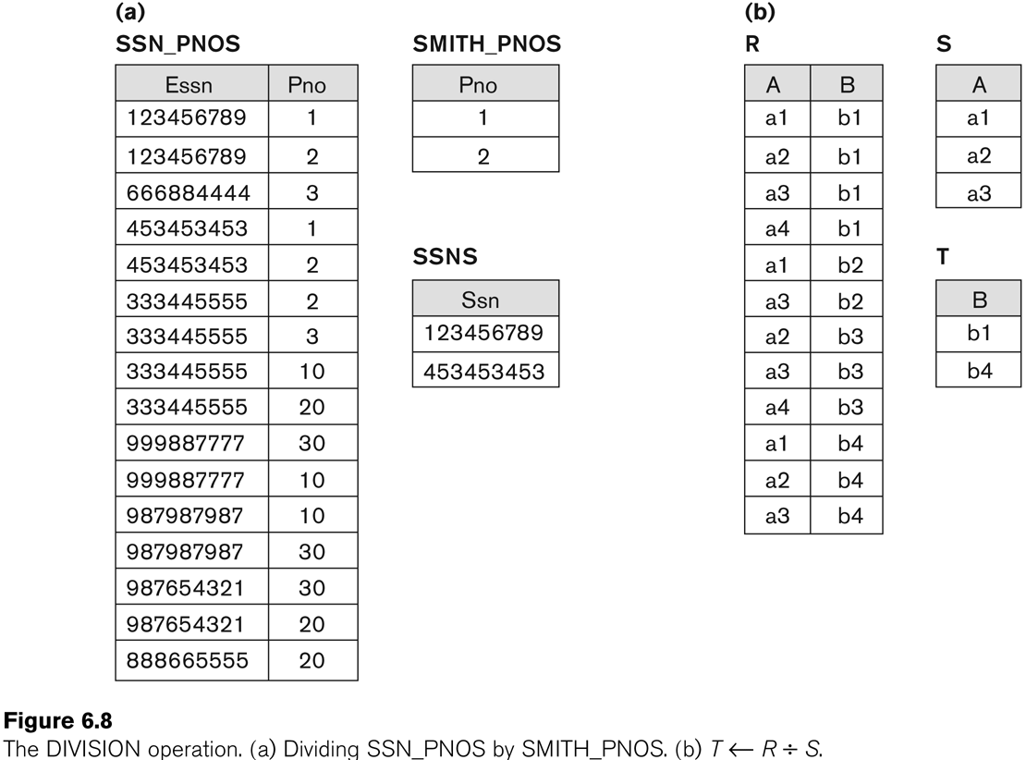
Example of DIVISION
1. algebra CS4222
1-<number>

Slide 47
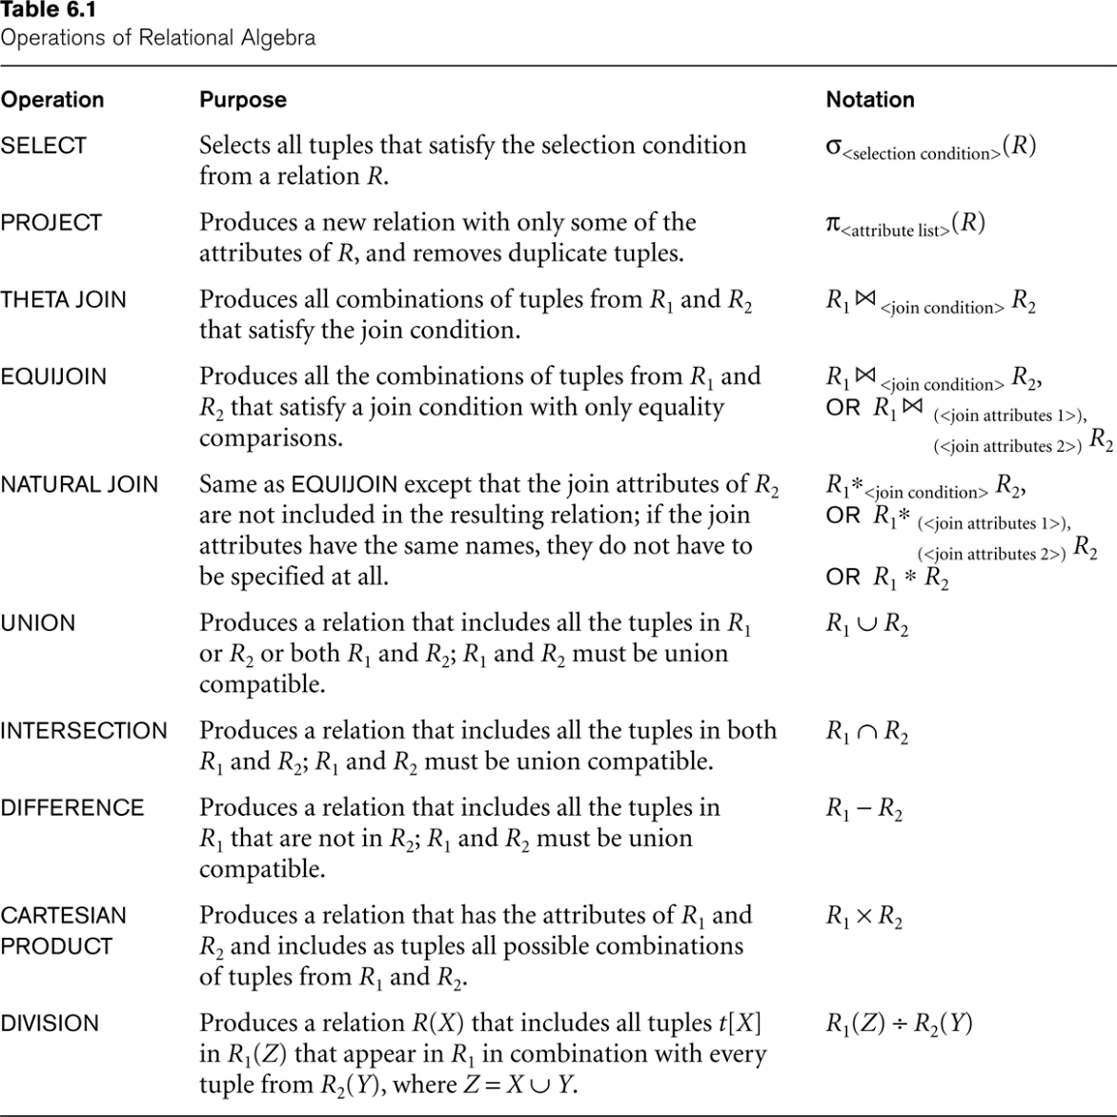
Recap of Relational Algebra Operations
1. algebra CS4222
1-<number>

Slide 48
Additional Relational Operations: Aggregate Functions and Grouping
A type of request that cannot be expressed in the basic relational algebra is to specify mathematical aggregate functions on collections of values from the database.
Examples of such functions include retrieving the average or total salary of all employees or the total number of employee tuples.
  These functions are used in simple statistical queries that summarize information from the database tuples.
Common functions applied to collections of numeric values include
  SUM, AVERAGE, MAXIMUM, and MINIMUM.
The COUNT function is used for counting tuples or values.
1. algebra CS4222
1-<number>

Slide 49
Aggregate Function Operation
Use of the Aggregate Functional operation ℱ
  ℱ_{MAX Salary} (EMPLOYEE) retrieves the maximum salary value from the EMPLOYEE relation
  ℱ_{MIN Salary} (EMPLOYEE) retrieves the minimum Salary value from the EMPLOYEE relation
  ℱ_{SUM Salary} (EMPLOYEE) retrieves the sum of the Salary from the EMPLOYEE relation
  ℱ_{COUNT SSN, AVERAGE Salary} (EMPLOYEE) computes the count (number) of employees and their average salary
    Note: count just counts the number of rows, without removing duplicates
1. algebra CS4222
1-<number>

Slide 50
Using Grouping with Aggregation
The previous examples all summarized one or more attributes for a set of tuples
  Maximum Salary or Count (number of) Ssn
Grouping can be combined with Aggregate Functions
Example: For each department, retrieve the DNO, COUNT SSN, and AVERAGE SALARY
A variation of aggregate operation ℱ allows this:
  Grouping attribute placed to left of symbol
  Aggregate functions to right of symbol
  _{DNO} ℱ_{COUNT SSN, AVERAGE Salary} (EMPLOYEE)
Above operation groups employees by DNO (department number) and computes the count of employees and average salary per department
1. algebra CS4222
1-<number>

Slide 51
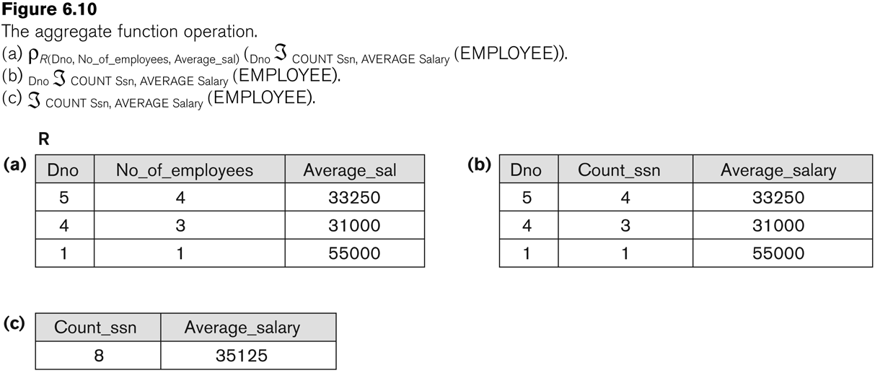
Examples of applying aggregate functions and grouping
1. algebra CS4222
1-<number>

Slide 52
Additional Relational Operations
The OUTER JOIN Operation
  In NATURAL JOIN and EQUIJOIN, tuples without a matching (or related) tuple are eliminated from the join result
    Tuples with null in the join attributes are also eliminated
    This amounts to loss of information.
  A set of operations, called OUTER joins, can be used when we want to keep all the tuples in R, or all those in S, or all those in both relations in the result of the join, regardless of whether or not they have matching tuples in the other relation.
1. algebra CS4222
1-<number>

Slide 53
Additional Relational Operations
The left outer join operation keeps every tuple in the first or left relation R in R S; if no matching tuple is found in S, then the attributes of S in the join result are filled or “padded” with null values.
A similar operation, right outer join, keeps every tuple in the second or right relation S in the result of R S.
A third operation, full outer join, denoted by keeps all tuples in both the left and the right relations when no matching tuples are found, padding them with null values as needed.
1. algebra CS4222
1-<number>

Slide 54
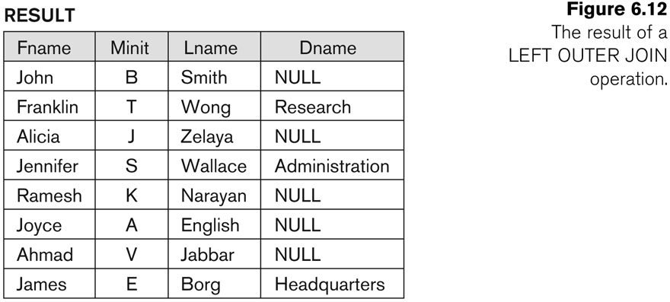
Additional Relational Operations
Temp←(Employee
_{Ssn=Mgr_ssn} Department
Result ← π _{Fname, Minit,Lname, Dname}(Temp)
1. algebra CS4222
1-<number>

Slide 55
Examples of Queries in Relational Algebra : Procedural Form
Q1: Retrieve the name and address of all employees who work for the ‘Research’ department.
RESEARCH_DEPT ← σ DNAME=’Research’ (DEPARTMENT)
RESEARCH_EMPS ← (RESEARCH_DEPT _{DNUMBER= DNOEMPLOYEE}EMPLOYEE)
RESULT ← π FNAME, LNAME, ADDRESS (RESEARCH_EMPS)
Q6: Retrieve the names of employees who have no dependents.
ALL_EMPS ← π SSN(EMPLOYEE)
EMPS_WITH_DEPS(SSN) ← π ESSN(DEPENDENT)
EMPS_WITHOUT_DEPS ← (ALL_EMPS - EMPS_WITH_DEPS)
RESULT ← π LNAME, FNAME (EMPS_WITHOUT_DEPS * EMPLOYEE)
1. algebra CS4222
1-<number>

Slide 56
Examples of Queries in Relational Algebra – Single expressions
As a single expression, these queries become:
Q1: Retrieve the name and address of all employees who work for the ‘Research’ department.
π _{Fname, Lname, Address} (σ Dname= ‘Research’
(DEPARTMENT Dnumber=Dno(EMPLOYEE))
Q6: Retrieve the names of employees who have no dependents.
π _{Lname, Fname}((π _{Ssn} (EMPLOYEE) − ρ _{Ssn} (π Essn (DEPENDENT))) ∗ EMPLOYEE)
1. algebra CS4222
1-<number>

Slide 57
Exercise
Q2: For every project located in “Stafford”, list the project number, the controlling department number, and the department manager’s last name, address and birth date
STAFFORD_PROJS ← σ _{Plocation=“Stafford”} (PROJECT)
CONTR_DEPT ← (STAFFORD_PROJS _{Dnum=Dnumber} DEPARTMENT)
PROJ_DEPT_MGR ←(CONTR_DEPT _{Mgr_ssn=Ssn} EMPLOYEE
RESULT ← πPnumber, Dnum,Lname,Address,Bdate(PROJ_DEPT_MGR)
1. algebra CS4222
1-<number>

Slide 58
Exercise
Q3: Find the name of employees who work on all the projects controlled by department number 5
DEPT5_PROJS(Pno)← π_{Pnumber}(σ_{Dnum=5}(PROJECT))
EMP_PROJ(Ssn, Pno)←π_{Essn,Pno}(WORKS_ON)
RESULT_EMP_SSNS←EMP_PROJ ÷ DEPT5_PROJS
RESULT ← π_{Lname, Fname}(RESULT_EMP_SSNS * EMPLOYEE)
1. algebra CS4222
1-<number>

Slide 59
Exercise
Q4. Make a list of project numbers for projects that involve an employee whose last name is “Smith”, either as a worker or as a manager of the department that controls the project
SMITHS(Essn) ← π _{Essn} (σ_{Lname=“Smith”}(EMPLOYEE)
SMITH_WORKER_PROJS ← π _{Pno} (WORKS_ON * SMITHS)
MGRS ← π _{Lname, Dnumber}(EMPLOYEE _{Ssn=Mgr_ssn} DEPARTMENT)
SMITH_MAGAGED_DEPTS(Dnum) ← π_{Dnumber} (σ_{Lname=“Smith”} (MGRS)
SMITH_MGR_PROJS(Pno) ← π_{Pnumber}(SMITH_MAGAGED_DEPTS * PROJECT)
RESULT← ( SMITH_WORKER_PROJS U SMITH_MGR_PROJS)
1. algebra CS4222
1-<number>

Slide 60
Exercise
Q5 list the names of all employees with two or more dependents
T1 ←(Ssn, No_of_dependents) ← _{Essn} ℱ_{Count Dependent_name}(DEPENDENT)
T2 ← σ _{No_of_dependents>=2} (T1)
RESULT ← π _{Lname, Fname} (T2 * EMPLOYEE)
1. algebra CS4222
1-<number>

Slide 61
Exercise
Q7. List the names of managers who have at least one dependent
MGRS(Ssn)← π_{Mgr_ssn}(DEPEARTMENT)
EMPS_WITH_DEPTS(Ssn) ← π_{Essn} (DEPENDENT)
MGRS_WITH_DEPS←(MGRS EMPS_WITH_DEPS)
RESULT← π_{Lname, Fname} (MGRS_WITH_DEPS * EMPLOYEE)
U
1. algebra CS4222
1-<number>

